Slide 1
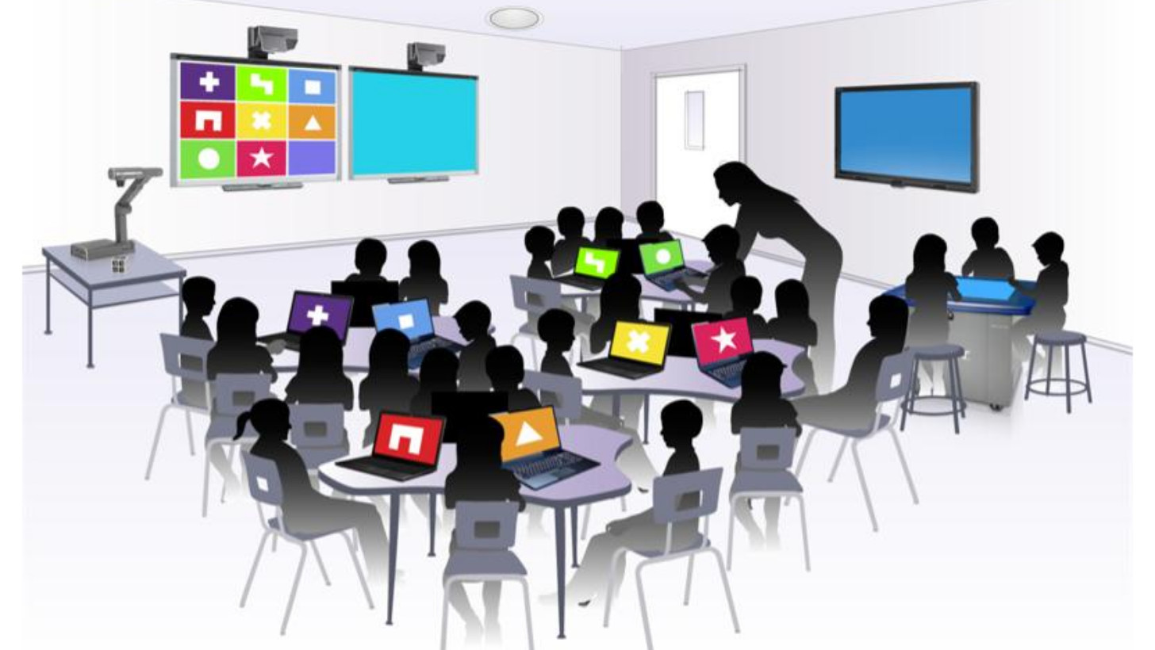
The digital Class

Slide 2
The development of technology and national plans for education allow today to bring ICT within the class in a easier way than it was in the past. The classroom is the place by definition assigned to pedagogical action

Slide 3
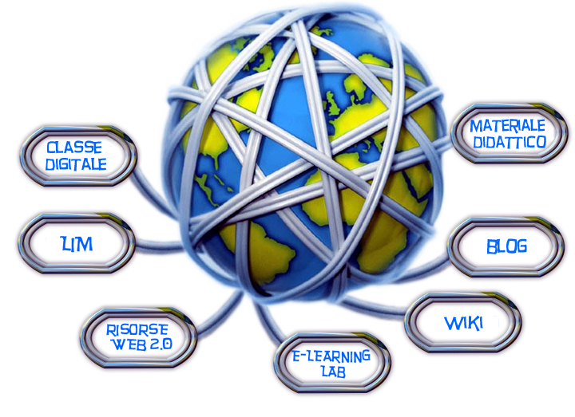
Changing the learning environment, involves a rethinking of the lesson and finally requires the teacher to change his methodology and the communicative approach with the students: the lesson is digital not only because they use software and the Internet, but above all because they use technology in the classroom for everyday lessons. The changes in the context, requires the teacher to redesign the space and improve the dynamics between the subjects who inhabit it.

Slide 4
Critical Issues to be faced in the change:
1. first problem: Teachers must acquire the skills necessary to read and produce digital content.
2. second problem: it is less evident, because it concerns the impact on the teacher's methodology, the communicative practice of the class and the didactic relationship between the teacher and the students and the relationship among the students.

Slide 5
The problem of digital content
The problem of digital content concerns the skills to be owned to use software and produce content.
The skills to be acquired are called litteracy.
there is therefore a first and more obvious technical litteracy in the use of the computer,
and there is also a media litteracy, that is the competence in writing using multiple languages, managing the multiple effects of meaning that multimedia necessarily produces compared to an exclusively alphabetic writing.

Slide 6
Methodology
Once the teacher has a good managing of the tool and is able to build content using different languages, the next step is the use in the classroom.
It should be added that technology is becoming increasingly classroom-oriented (think of interactive multimedia whiteboards), on the other hand increasingly portable (netbooks, tablets and smartphones).
The first consequence is that the digital lesson does not take place in spaces like the laboratories, but involves all the spaces, with very different dynamics and interactions.

Slide 7
Renew communication practice
Technological setting in the class.
Kids can easily access tools for the self-production of digital content. In fact, they often have a smartphone with which they can produce images, videos and audio recordings. Even the school will easily be equipped with digital cameras, which can also produce videos.
Giving children the opportunity to "participate" directly in the production of content.
The teacher becomes a class guide in the development of the digital lesson. He produces digital contents, and puts the children in a position to "know how to write" using the different languages.
The students thus become an active part of the pedagogical process: a digital content can easily be assembled and modified.

