Slide 1
SCHOOL “TIBERIU MORARIU “SALVA,ROMANIA PROJECT ERASMUS + B.L.E.N.D 2017-1-FR-01-KA219-037364_6 LIVERPOOL U.K SHORT TERM TRAINING EVENT FOR STAFF 22-24th May 2018

Slide 2
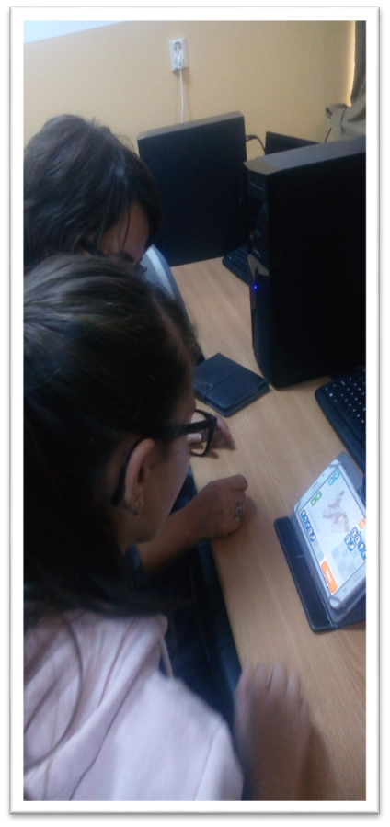
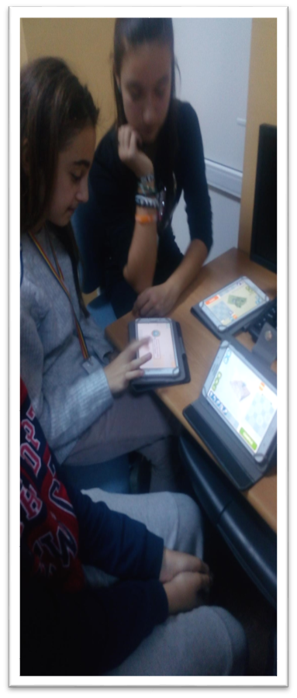
What digital technologies are used in your school, and how they are used?
In our school( School Tiberiu Morariu Salva,Romania) the presence of technology is still precarious due to the limited financial resources form local community and due to the minimal endowments made by the ministry of education.
In most classes from kindergartens and primary cycle teachers use personal laptops to make their content more attractive. Through a donation of a foundation, this year made acquisition of a projector for primary classes to increase the interaction of students with digital content.

Slide 3
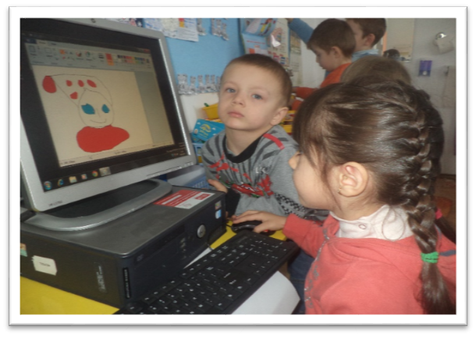
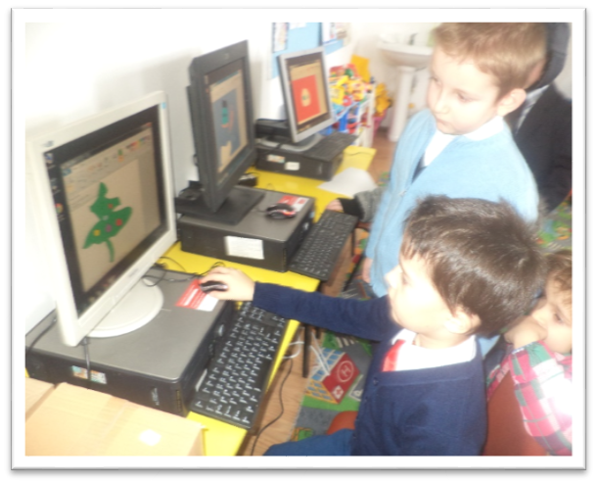
What digital technologies are used in your school, and how they are used?
Since 2014, the education ministry has introduced interactive books in primary school classes with CDs with different scientific content presented as interesting games or applications, but these games are especially used by students at home because of the lack of smart class board.
Through Digitaliada program and Orange foundation in 2016 we won an IT laboratory for secondary school children equipped with 15 PC ,projectors and 24 tablets, smart board. This project focused on the development of scientific content especially in mathematics through games and practical applications to reduce the degree of abstraction.

Slide 4
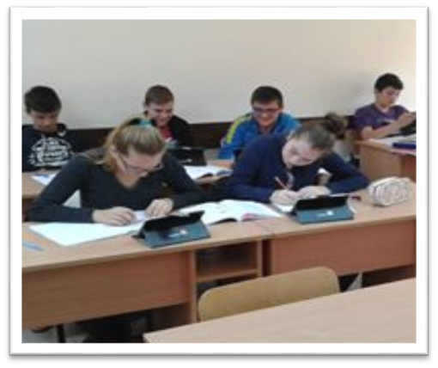
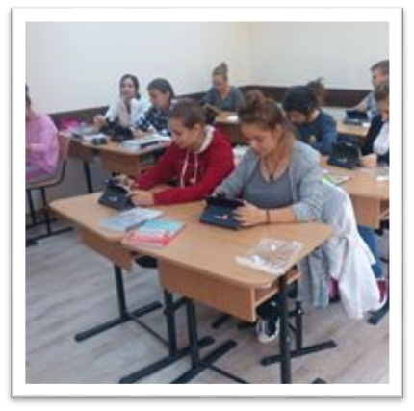
What digital technologies are used in your school, and how they are used?
Since 2014, the education ministry has introduced interactive books in primary school classes with CDs with different scientific content presented as interesting games or applications, but these games are especially used by students at home because of the lack of smart class board.
Through Digitaliada program and Orange foundation in 2016 we won an IT laboratory for secondary school children equipped with 15 PC ,projectors and 24 tablets, smart board. This project focused on the development of scientific content especially in mathematics through games and practical applications to reduce the degree of abstraction.

Slide 5
THANK YOU FOR ATTENTION!
VASILICA GAZDAC
THIS PROJECT HAS BEEN FUNDADED WITH SUPPORT FROM THE EUROPEAN COMISSION. THIS PUBLICATION REFLECTS THE VIEWS ONLY OF THE AUTOR, AND THE COMISSION CANNOT BE HELD RESPONSIBLE FOR ANY USE WICH MAY BE MADE OF THE INFORMATION CONTAINED THERE IN.

